Slide 1
Health Center Fee
“Providing the Services and Support to Achieve Your Highest Potential”
STUDENT WELLNESS
December 7, 2018
Dr. Mary Becerra, Acting Director
Student Health Services,

Slide 2
Overview
Governance
History
Fee Proposal Fall 2011
Revenues and Expenditures
Purpose
What We Have Accomplished
Mental Health Services
Education and Prevention
Questions

Slide 3
Governance
Student Wellness – Management Team
Associate Vice President of Student Affairs
Director of Counseling and Psychological Services
Director of Disability Support Services
Director of Health Services
Senior Coordinator of TitanWell

Slide 4
Governance
Management Team
Director of Health Services
Director of Counseling and Psychological Services
Director of Disability Support Services
Senior Coordinator TitanWell
SHAC (Student Health Advisory Committee)
Students
Faculty
Staff
Executive Order 943
AAAHC Accreditation (Accreditation Association of Ambulatory Health Care)

Slide 5
History
The Policy of the Board of Trustees on Student Health Services was adopted initially as a comprehensive system-wide policy in 1977.
Revised in May 1988 and required that basic student health services be available to all regularly enrolled students at no additional charge.
Treatment for illnesses and injuries
Family planning services
Health education
Counseling for individual health problems
In addition, the policy allowed campuses to offer additional elective, “augmented” services free of charge or for a fee.
Nurse Couper
From 2001 Audit Report

Slide 6
More History
In the early 1990’s, a dramatic change to the fiscal climate prompted a reevaluation of the existing policy.
Several CSU campuses reported an inability to provide basic health services without additional revenue.
Accordingly, in November 1992, the Board of Trustees delegated to the Chancellor the authority to approve exceptions to the fee restrictions of the policy.
Such exceptions were permitted with the understanding that a task force would undertake a comprehensive review of the provision and financing of student health services.
1994 – CSUF Students Voted for a Mandatory Health Fee of $40 per year

Slide 7
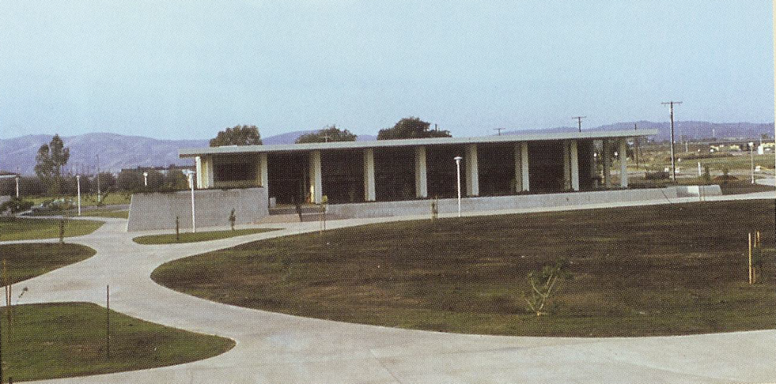
Even More History
1997/98 Fee was $50 per year
10 Year Health Center Fee History
 | 07/08 | 08/09 | 09/10 | 10/11 | 11/12 |  |  | 15/16 | 16/17 | 17/18
Spring 13
Spring 14
Spring 15
Health Services | $85 | $90 | $90 | $90 | $90 |  |  | $160 | $160 | $163
Fall 12
Fall 13
Fall 14
$70 $72 $74 $76 $78 $80
Health Fee 2018-2019: $168
In August 1995, Executive Order 637, CSU Policy on Student Health Services was issued
Updates to the Executive Order
2002 - EO 814
2005 - EO 943

Slide 8
What Was Proposed and Approved in Fall 2011?
Fall 2011
Increase fee from $45/sem. to $70/sem. (Fall 2012) and $2 increments each semester for 5 semesters
Fall 2018 - $84.00/semester
Recommended to evaluate health fee every 8-10 years
Changing needs of the campus
Student health status
Facility improvements/upgrades
Changes in salaries and benefits

Slide 9
2018-2019 System-Wide Health Center Fee
Maritime | $680
San Luis Obispo | $612
Humboldt | $576
Chico | $474
Sonoma | $414
Stanislaus | $400
East Bay | $375
San José | $364
San Marcos | $322
Bakersfield | $317
San Francisco | $314
San Diego | $300
Los Angeles | $265
San Bernardino | $261
Pomona | $255
Sacramento | $244
Fresno | $226
Channel Islands | $190
Monterey Bay | $186
Fullerton | $168.90
Dominguez Hills | $150
Long Beach | $150
Northridge | $120
Average: $320
CSUF fee is almost two times less than the average.

Slide 10
2017-2018 Fiscal Year
Revenue & Expenses
Revenue
$80.00 Summer - 1,013 students $81,040
$81.44 Fall – 40,439 students $3,293,352
$81.44 Spring – 39,341 students $3,203,931
Deposits to cashier (Health Services) $184,585
Total Revenue Collected 2017-2018: $6,762,908
Expenses
Salaries $8,453,756
Management Salaries, Counseling, Psychiatry
Health Services, TitanWell, Benefits
Supplies $1,004,281
Supplies, Services, Programming Materials
Total Expenses: $9,458,037

Slide 11
Purpose
High quality, student-centered wellness services
Primary care and behavioral healthcare
International Recommendations for Counselor to Student Ratio – 1:1000/1500
Growing Nation-wide Mental Health Crisis on College Campuses
Data From our Campus
NCHA
Major Depression
Aggressive Behavior
Depressed/Difficult to Function (42.7% - 16,798)
Overwhelming Anxiety (64% - 25,178)
Overwhelming Anger (47% - 18,490)
Seriously Considered Suicide (12.5% - 4,917)
Attempted Suicide (1.5% - 590)
Intentional self-injury (6.1% - 2,399)

Slide 12
Purpose
Increased Demand, especially in crisis services
Increased Severity
Barrier to Access in the Community/Cost
Training for Faculty, Staff & Students
Campus Resource for a Safer Campus Community

Slide 13
What has been accomplished?
17 Counselors
Including 1 full time person at the Irvine Campus
Plus 3 Doctoral Interns from our APA Accredited Internship Program
2 Case Managers
Receptionist
Ratio Change: 1 to 2,285 With Interns: 1 to ~2,000
Current Ratio: 1 to 1800 Recommended ratio 1:1400
Increased Psychiatric Services
Addition of Full Time Psychiatric Nurse Practitioner
After Hours 24/7 Call Service ProtoCall

Slide 14
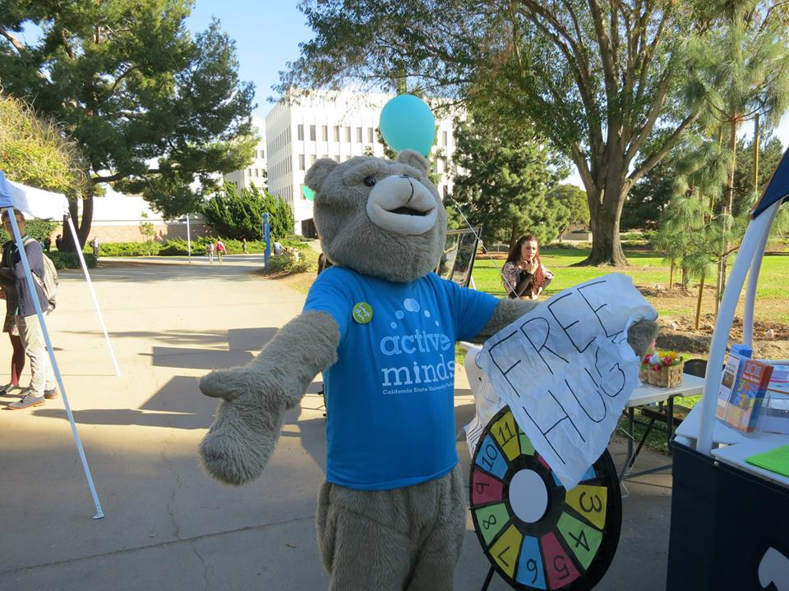
What has been accomplished?
Primary Care Provider to patient – 1 to 2500
Current CSUF ratio – 1 to 4,971
Recruiting for three Providers (2 Physicians, 1 Nurse Practitioner) - replacements
Expanded Campus Support and Training
Expansion of TitanWell/Health Education and Prevention
TitanWell HUT – On campus 4 hours a day, in different locations, three days a week
BACCHUS Peer Health Educators
Nutrition Advocates/Peer Program
Active Minds
Addition of Health Educator and Dietician

Slide 15
What has been accomplished?
Flu Clinic dispensed over 1,400 vaccines in fall 2018
Wellness Classes
Art of Wellness
Mood Wellness
Stress Wellness
Thought Wellness
Yoga as Healing
Student Wellness Without Walls
The TitanWell Hut
Collaboration with many areas on campus
Fullerton Flu Fighters

Slide 16
Ongoing & Basic Augmented Services
Primary Care Medical Visits
Radiology
Pharmacy
Family PACT Family Planning Services
Laboratory Services
Immunization Services
Counseling
Psychiatry
Physical Therapy
Orthopedics and Sports Specialist
Chiropractic
Acupuncture
Optometry
Walk-In Care

Slide 17
Statistics
Ongoing & Basic Augmented Services
Fall 2017 Number of visits
Primary Care 7115
Nursing 3157
TitanWell 165
PTSR 1657
Chiropractic 1148
Acupuncture 14
Psychiatry 730
Orthopedics 161
Optometry 33
Family PACT 915

Slide 18
Ongoing & Basic Augmented Services
SERVICE | # APPOINTMENTS
ACUPUNCTURE | 106
CAPS | 7,635
CHIROPRACTOR | 3,098
FAMILY PACT | 1,926
NURSING | 7,111
OPTOMETRY | 77
ORTHOPEDICS | 331
PHYSICAL THERAPY SPORTS REHABILITATION | 3,874
PRIMARY CARE | 15,059
PSYCHIATRY | 1,627
TITANWELL (CLINICAL APPOINTMENTS ONLY) | 445
GRAND TOTAL: | 41,289
DEPARTMENT | # STUDENTS SERVED
CAPS | 2,721
Health Services | 16,189
GRAND TOTAL: | 18,910

Slide 19
Ongoing & Basic Augmented Services
CAPS 2017-2018 Statistics
6.7% of the CSUF student body used services at CAPS
Provided 7,635 counseling and 1,627 psychiatric appointments which were utilized by 2,721 students
Each semester, CAPS offered 4 weekly psychotherapy groups to provide students with added counseling support
Case Management was provided for 150 students with 274 case management appointments
Participated in 202 Outreach Events, serving 4,375 students
Yoga as Healing and Eating Task Force
65 Wellness Workshops were offered, introducing Connections of the heART
Daily Walk-in/Crisis : 619 appointments for 525 students
Irvine Campus: 1 Full time counselor provided 492 psychotherapy appointments to 120 students

Slide 20
Ongoing & Basic Augmented Services
Titan Well 2017-2018 Statistics
Total attendance for workshops, individual appointments, campus events, and the Titan Hut was 29,094
Over 30,000 condoms distributed through Condom Availability Program (CAP)
630 free, balanced meals to food insecure students through FOODucation workshops and Titan Bites
1,428 student respondents in NCHA survey, spring 2018
Dog Therapy – over 1,000 students
Programming included:
Sleep Health
Stress Management
Nutrition Workshops
Sexual Health
Alcohol and Other Drugs
New for 2018-2019:
Gastronome food workshops
Sex in the Rec (Nov. ‘19)

Slide 21
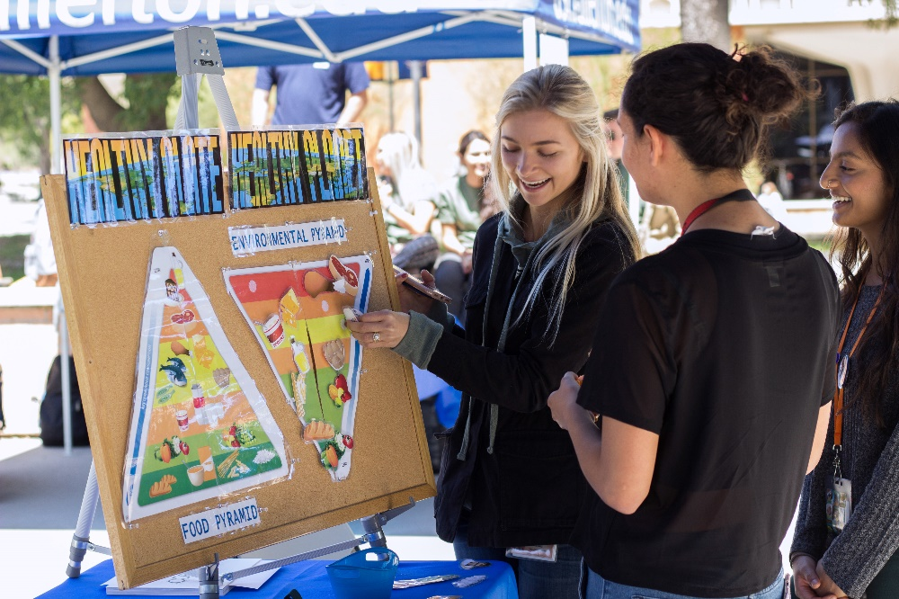
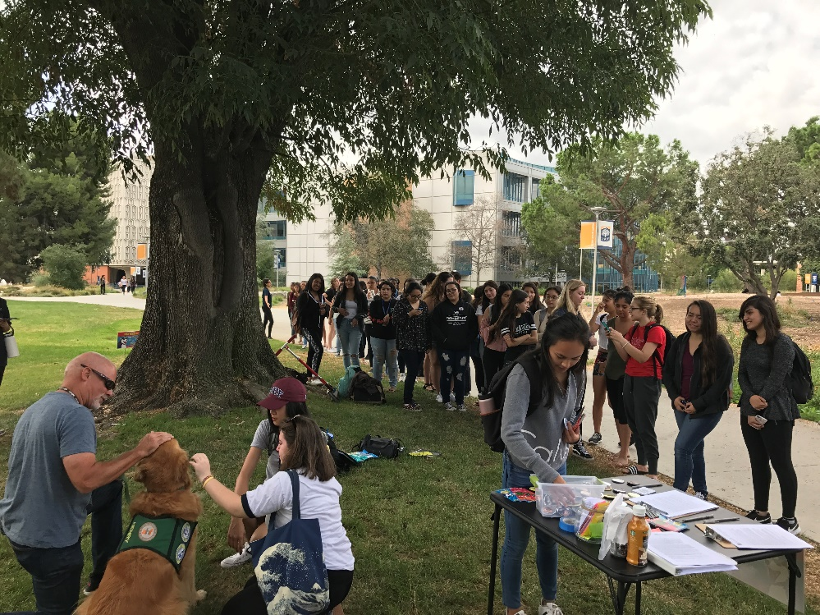
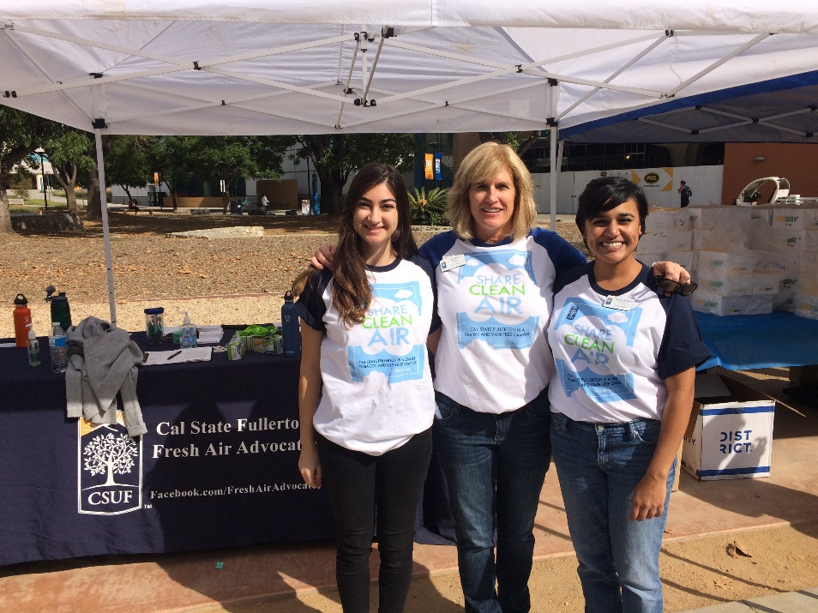
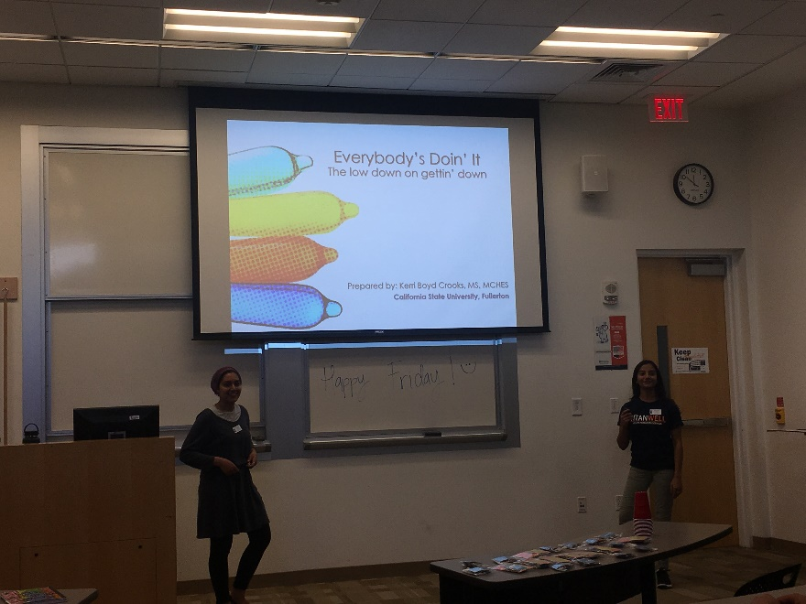
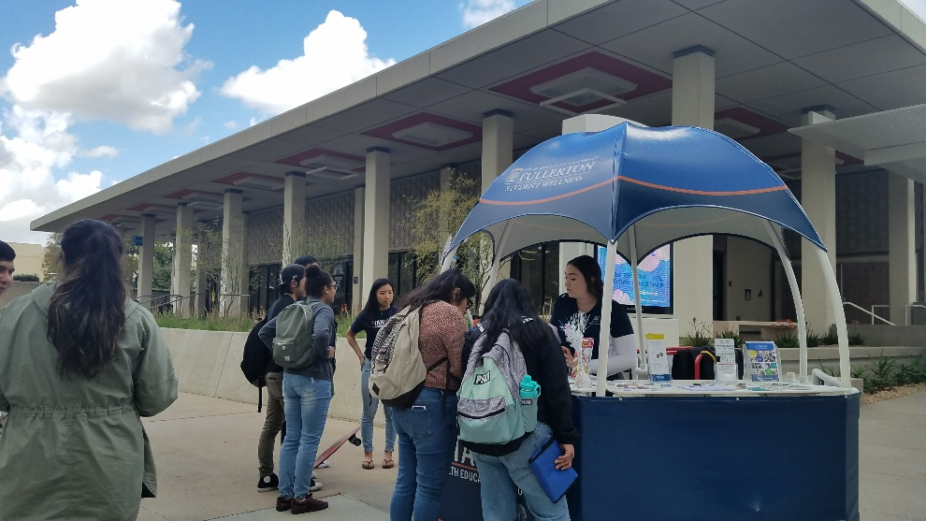

Slide 22
Questions?

