Slide 1
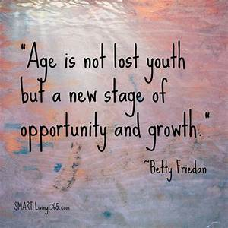
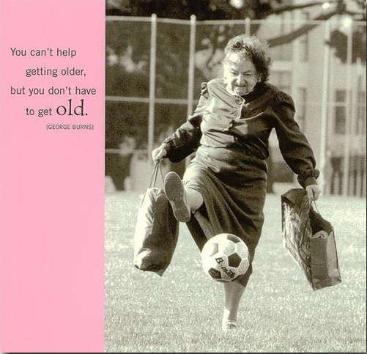
CSUF Aging Studies Academic Program Looking towards the future….
Presented by
CSUF Aging Studies Academic Program
P: 657-278-7057
agingstudies@fullerton.edu

Slide 2
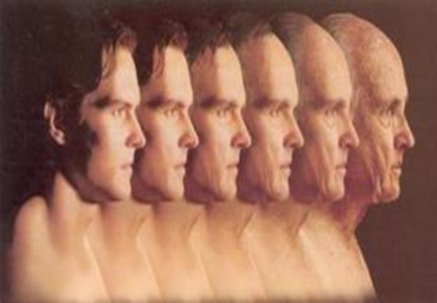
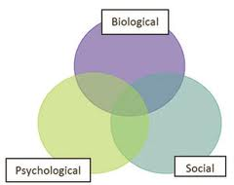
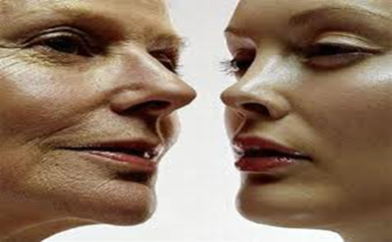
AGING STUDIES IS…
Field of study that focuses on understanding the biological, psychological, social, political and cultural factors that influence people’s lives.

Slide 3
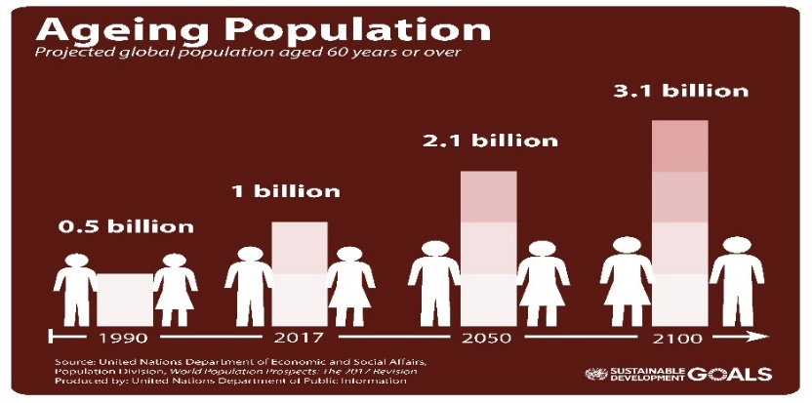
WHY PURSUE A MINOR IN AGING STUDIES
Emerging multi-disciplinary field
Unprecedented growth of the older population
Growing demand for well-trained specialists
Graying of America.
-2010: 40 million Americans 65+ (13%)
-2020: 16.5% of Americans will be 65+ (54 million)
-2030: 19% (72 million); 1 out of 5 people

Slide 4
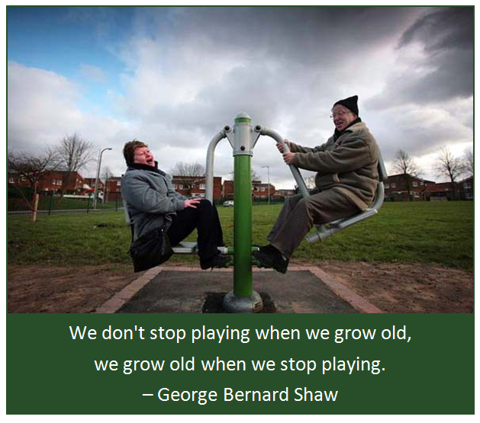
WHY AGING studies
Students, regardless of their discipline or field, will come into contact with the aging population and their families. Become more marketable with coursework in aging!
Aging is currently one of the top 10 careers

Slide 5
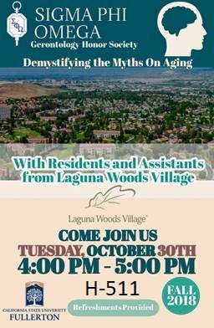
WHY CSUF?
Minor = 21 units, Major overlap, GE overlap
http://hss.fullerton.edu/agingstudies/minorreqs/
Sigma Phi Omega
Scholarships, 5⁺, up to $2500

Slide 6
The AGING STUDIES MInor
21 Units = 7 classes*
3 classes can overlap with the major
Some classes fulfill GE requirements (e.g.,
AGNG 133; AGNG 313)
Courses taught by dozens of faculty from
various academic disciplines
* fewer courses required if a community college Aging Studies/Gerontology certificate was completed

Slide 7
Potential Classes (* = GE)
Lower-Division Requirements (3 units)
Aging Studies 133 Introduction to Gerontology (3)* (Same course as HUSR 133, PSYC 133, PUBH 133, and SOCI 133) Upper-Division Requirements (9 units from the following)
Aging Studies 313 California Gold: Diversity and Aging (3)*
Biology 306 Biology of Aging (3)*
Kinesiology 454 Physical Dimensions of Aging (3)
Psychology 362 Psychology of Aging (3)*
Sociology 443 Sociology of Aging (3)
Internship (3 units)
One three-unit internship at the 300/400 level in a related field. An internship is a supervised experience working within the community. Internships are coordinated through the student’s major department. You may also take AGNG 495, the Aging Studies Internship Class.

Slide 8
Choose from the following Electives (6 UNITS) * = offers at least one GE course
AGNG (4) *
ANTHRO (2)
BIO (3) *
CAS (1) *
FIN (2)
HCOM (2) *
HUSR (9) *
KNES (6) *
MGMT (1)
MKTG (1)
NURS (1)
PHIL (1) *
PSYC (9)
PUBH (6) *
SOCI (6) *

Slide 9
How to add the aging Studies MInor
Complete the online Major/Minor Change Form: http://records.fullerton.edu/resources/majorminorform.php
Submit the form (online) to the Aging Studies Academic Program for approval and signature.
Addition of a first minor is free.

Slide 10
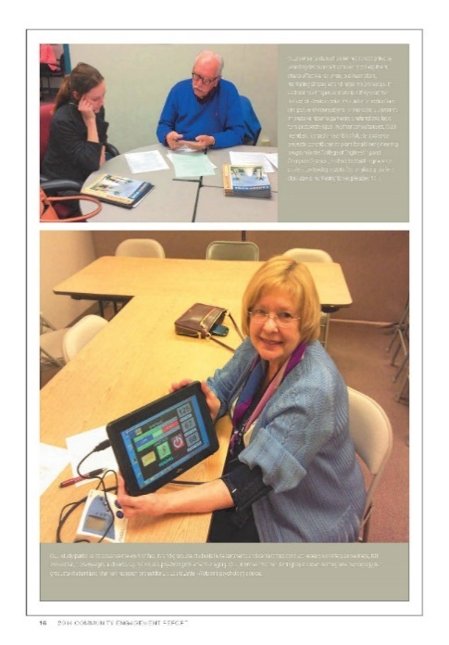
We look forward to working with you in the future.
Please feel free to contact us with questions:
agingstudies@fullerton.edu
Or phone: 657-278-7057
And for more information, please visit:
http://hss.fullerton.edu/agingstudies
WHY NOT CHECK US OUT?

